Slide 1

Stage 8 The People’s Vote Course Designer: Keith Tsang
The People’s Vote is a 24 round, 120 point Standards Exercise course. There are 6 USPSA targets. The best 4 hits per target will score. The start signal is audible.
For both strings, the Handgun start position is standing in the shooting area with wrists below belt. Handgun loaded and holstered. For both strings, the PCC start position is standing in the shooting area with safety on, stock on belt, muzzle pointing downrange.
String 1: On the audible start signal, engage all targets in either array 1 or array 2 with 2 shots each, perform a mandatory reload then engage all targets in the other array with 2 shots each strong hand only. String 2: On the audible start signal, engage all targets in either array 1 or array 2 with 2 shots each, perform a mandatory reload then engage all targets in the other array with 2 shots each weak hand only.

Slide 2
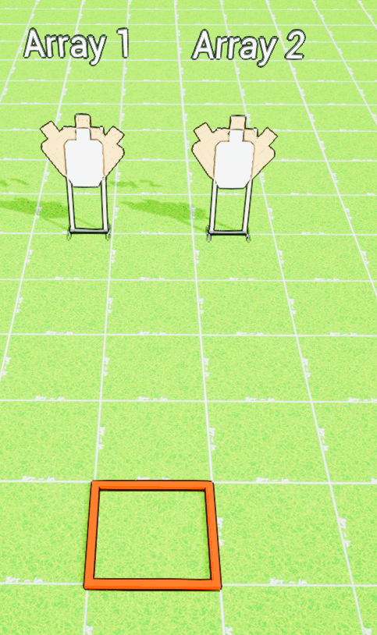
 | Stage 8 The People’s Vote Course Designer: Keith Tsang

